Slide 1



G H PATEL COLLEGE OF ENGINEERING & TECHNOLOGY
(THE CHARUTAR VIDYA MANDAL (CVM) UNIVERSITY)
DEPARTMENT OF COMPUTER ENGINEERING
The JDBC Connectivity Model & Database Programming
Advanced Java Programming(202045605)
Date: 13th October, 2026
Guided by
Dr. Hetal Gaudani
Assistant Professor(CP department)
Presented by
Dhruvi Patel(12402040501020)

Slide 2
SEMINAR ROADMAP
TABLE OF CONTENTS
01
Definition & Purpose of JDBC
05
Loading & Registering Drivers
02
JDBC Connectivity Architecture
06
Connection & JDBC URL
03
Four Types of JDBC Drivers
07
Creating & Executing SQL Statements
04
Basic Connectivity Workflow
08
Retrieving Results via ResultSet
09
Complete Example & Program Flow

Slide 3
SECTION 01 • FOUNDATION
DEFINITION OF JDBC
JDBC PROVIDES STANDARD METHODS FOR:
JAVA DATABASE CONNECTIVITY
Connecting Java applications to a database.
JDBC is a Java Application Programming Interface (API) that allows Java programs to access and interact with a Database Management System (DBMS).
Executing SQL queries and statements.
Retrieving query results.
JDBC is a standard part of Java SE (Java Standard Edition) and uses JDBC drivers to connect Java applications with databases.
Performing insert, update and delete operations.
Executing stored procedures.

Slide 4

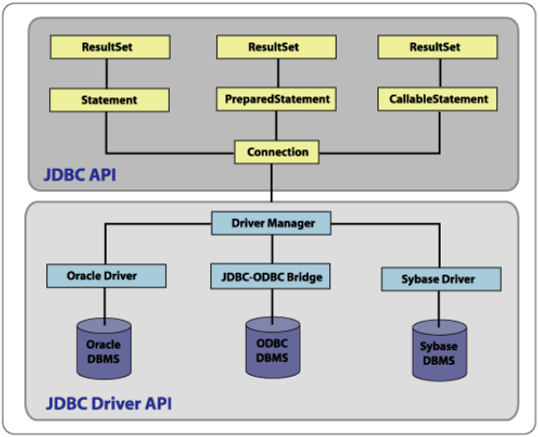
SECTION 02 • ARCHITECTURE
JDBC CONNECTIVITY MODEL & ARCHITECTURE
The JDBC connectivity model provides a standard mechanism through which a Java application communicates with a database using the JDBC API and a database-specific JDBC driver.
BASIC CONNECTIVITY MODEL
Java
App
JDBC
API
DriverManager
JDBC
Driver
Database
ROLE OF THE JDBC DRIVER
The JDBC driver translates Java/JDBC calls into database-specific calls and handles communication between the Java application and the database server.

Slide 5
SECTION 03 • DRIVER CLASSIFICATION
FOUR TYPES OF JDBC DRIVERS
Type | Driver Name | Description & Mechanism
Type 1 | JDBC-ODBC Bridge | Uses ODBC as a bridge between JDBC and database.
Type 2 | Native-API / Partly Java | Uses Java Native Interface (JNI) and native database libraries.
Type 3 | All Java / Net-Protocol | Uses JDBC middleware and network protocol.
Type 4 | All Java / Native-Protocol | Pure Java driver that communicates directly with the database.

Slide 6
SECTION 04 • EXECUTION LIFECYCLE
BASIC JDBC CONNECTIVITY STEPS
STEP 01
STEP 02
STEP 03
STEP 04
STEP 05
Establish Connection
Create Statement
Execute SQL
Get ResultSet
Close Connection
Register/load driver and create connection using DriverManager.
Create Statement object using the connection.
Execute required SQL query using statement object.
Retrieve returned records through ResultSet for SELECT.
Close connection after completing database operations.

Slide 7
SECTION 05 • INITIALIZATION
STEP 1: REGISTER / LOAD THE DRIVER
THREE REGISTRATION APPROACHES:
A. DriverManager.registerDriver()
SYNTAX & VENDOR SPECIFICATION
DriverManager.registerDriver(new sun.jdbc.odbc.JdbcOdbcDriver());
General Syntax
Class.forName("driver_class_name");
B. Class.forName() [Primary Approach]
MySQL Driver Implementation
Class.forName("sun.jdbc.odbc.JdbcOdbcDriver");
Class.forName("com.mysql.cj.jdbc.Driver");
C. Using System Property
System.setProperty("jdbc.driver", "sun.jdbc.odbc.JdbcOdbcDriver");
The MySQL driver class is com.mysql.cj.jdbc.Driver, provided by the corresponding MySQL Connector JAR.

Slide 8
SECTION 06 • CONNECTION & CONFIGURATION
STEP 2: ESTABLISH THE CONNECTION
METHOD SYNTAX
IDENTIFIER
INTERFACE
getConnection()
JDBC URL
Connection Interface
Returns a Connection object representing the session with the database.
Identifies the target database: jdbc:: (vendor protocol + host/port/database).
Factory for statement objects and transaction control.
Connection con =
DriverManager.getConnection(url);
Connection con =
DriverManager.getConnection(
url, username, password);
DriverManager.getConnection(
"jdbc:mysql://
10.10.13.202:3306/test",
username,
password);
Factory For: Statement, PreparedStatement, DatabaseMetaData
Transactions: commit(), rollback(), setAutoCommit()

Slide 9
SECTION 07 • SQL EXECUTION
CREATING & EXECUTING SQL QUERIES
Create Statement Object: Statement stmt = con.createStatement();
Executes SQL against database
QUERY EXECUTION
DATA MODIFICATION
GENERAL EXECUTION
1. executeQuery()
2. executeUpdate()
3. execute()
Executes SELECT queries and returns a ResultSet containing retrieved records.
Executes INSERT, UPDATE, DELETE, CREATE, DROP. Returns integer count of affected records.
Executes SQL statements that may return multiple results. Returns boolean.
ResultSet rs =
stmt.executeQuery(sql);
int rowsAffected =
stmt.executeUpdate(sql);
boolean result =
stmt.execute(sql);

Slide 10
SECTION 08 • DATA RETRIEVAL
GETTING RESULTS VIA RESULTSET
The ResultSet Cursor
READING RECORDS EXAMPLE
The ResultSet contains a cursor pointing to the current record. Initially, the cursor is positioned before the first record; calling next() moves it to the next available record.
while (rs.next()) {
int ssn = rs.getInt("SSN");
String name = rs.getString("NAME");
int marks = rs.getInt("MARKS");
}
rs.next() Navigation
Returns true as long as there is another valid record to process, enabling clean sequential loops.
Values can be extracted by column name label or by 1-based numerical column index.

Slide 11
SECTION 09 • IMPLEMENTATION
COMPLETE EXAMPLE & PROGRAM FLOW
EXECUTION FLOW OF PROGRAM
1. Import java.sql.*
import java.sql.*;
2. Load JDBC Driver (Class.forName)
class MysqlCon {
public static void main(String args[]) {
3. DriverManager.getConnection()
try {
Class.forName("com.mysql.cj.jdbc.Driver");
Connection con = DriverManager.getConnection(
"jdbc:mysql://localhost:3306/test", "root", "root");
4. Obtain Connection Object
Statement stmt = con.createStatement();
String query = "SELECT * FROM student";
ResultSet rs = stmt.executeQuery(query);
while (rs.next()) {
5. createStatement() → Statement Object
System.out.println(rs.getInt(1) + " " + rs.getString(2) + " " + rs.getInt(3));
}
con.close();
6. executeQuery() → ResultSet
} catch (Exception e) { System.out.println(e); }
}
}
7. rs.next() → Display Records
8. con.close()

Slide 12
THANK YOU

